Slide 1
SPEED & VELOCITY
OBJECTIVE: Students will know how to measure and graph distance and speed as a function of time using moving toys and be able to describe an object's motion; using position, displacement, speed, and acceleration.

Slide 2
WHY SHOULD WE STUDY VELOCITY?
What reasons can you come up with for why it’s important to study speed?
Brainstorm three in your group.

Slide 3
DEFINITION
Speed - describes how fast something moves
Example: I was driving 25 mi/hr
Velocity – describes both speed and direction
Example: The hurricane was moving 120 mi/hr due North.

Slide 4
Formula
Velocity and Speed are calculated the same way
Distance / Time
Each variable has different units:
Distance = meters (m), mi (miles), cm (centimeters)
Time = hours (hrs), second (s), days
Speed = a combination of the other two: m/hr, m/s, mi/day etc.

Slide 5
Practice Problem #1
Metal stakes are sometimes placed in glaciers to help measure a glacier’s movement. For several days in 1936, Alaska’s Black Rapids glacier surged as swiftly as 89 m in two days down the valley. Find the glaciers speed.
Knowns | Formula | Substitution | Answer with units
Knowns | Formula | Substitution | Answer with units
D = 89 m T = 2 days | S=D/T | S = 89 m/ 2 day | S = 44.5 m/days

Slide 6
Practice Problem #2
Find the velocity of a swimmer who swims exactly 110 m toward the shore in 72 s.
Knowns | Formula | Substitution | Answer with units

Slide 7
Distance-Time Graphs
What could be some possible reasons for these lines?

Slide 8
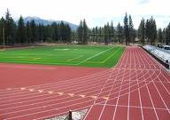
Is it possible to run 3 mi/hr without changing your position?
Yes!!!
Position is when an object’s starting and finishing points are compared.
Distance is how far the object traveled.

Slide 9
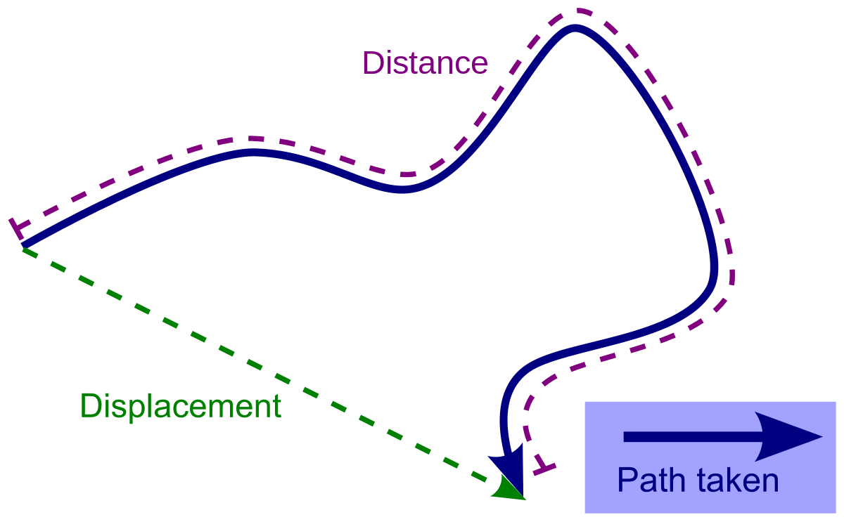
Displacement
Displacement: final position – initial position
Displacement is not always equal to the distance traveled. It can be positive or negative.
The velocity of an object can be positive or negative depending on the sign of displacement.
The time interval is always positive.

Slide 10
Different types of Speed/Velocity
Instantaneous Speed- is the speed at a specific point.
Constant Speed: when an object covers equal distances in equal amounts of time.
Like setting the cruise control in the car.
Average Speed: the total distance covered by an object divided by total amount of time.
Speed going from Austin to Houston
Negative Velocity: + and – signs are used to tell the direction of the object relative to it’s position (displacement) {i.e. If I drive from my home to my workplace (defining my positive direction in that way), then my velocity is positive if I go to work, but negative when I go home from work. It is all about direction seen from how I defined my positive axis.}

Slide 11
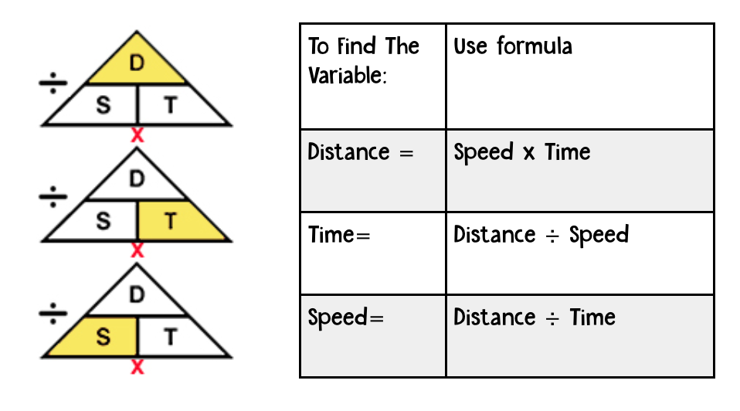
Need a different variable from than speed?
Q: Find the time if speed is 20 mi/hr and the distance is 50 mi.
Don’t freak out!! Rearrange the variables just like Algebra.

Slide 12
Try these on your own:
Find the velocity of a baseball thrown 38 m from third base to first bas in 1.7 s.
Calculate the distance of a cyclist would travel in 5.00 hours at an average speed of 12.0 km/hr.
Calculate the time in seconds an Olympic skier would take to finish a 55 km race at an average velocity of 28 km/s downhill?

Slide 13
If you forget just...
Remember This!!

